Slide 1
Tuberculosis Drugs
Spreadsheet Documentation

Slide 2
General Information
Link to spreadsheet: https://docs.google.com/a/binghamton.edu/spreadsheet/ccc?key=0Ag8gS12PpxX2dF82NS1CLVhwd1RDSjhiMnFpdGtUZVE&usp=drive_web#gid=1
Spreadsheet contains data regarding
Summary of company rankings
WHO groupings and country categorizations
The burden of Malaria and the data of its drugs by countries
The burden of TB and the data of its drugs by countries
The burden of HIV and the data of its drugs by countries

Slide 3
Tab (1) Summary of Company Rankings
List of pharmaceutical companies, their drugs and target diseases
Ranking of the companies’ total impact scores:
Total impact scores = Need (DALYs lost) * Access (Treatment coverage) * Efficacy
Ranking of the companies break down by diseases
Total DALYs alleviated in different diseases break down by WHO regions

Slide 4
Tab (4) Tuberculosis by Countries
General information
Column A: List countries
Column B: Countries sorted by WHO regions
Column C: population
Column D: DALYs lost to TB break down by countries (2010 data)

Slide 5
Tab (4) Tuberculosis by Countries
Different kinds of TB
Drug-susceptible (Normal) TB
Multiple drug resistant (MDR) TB
Extreme drug resistant (XDR) TB
TB and HIV
All TB Incident Cases
Drug-Susceptible ("Normal") TB
MDR-TB
XDR-TB
HIV+
HIV-

Slide 6
Tab (4) Prevalent and incidence cases
Column M and N: TB prevalence and incidence by countries
Prevalence: The total number of cases of disease existing in a population
Incidence: The total number of newly diagnosed cases of a disease
Column Q-T:
Incident cases of lactive TB with HIV+/HIV-
% of active TB with HIV+/HIV- = The number of active TB with HIV+ or HIV- / The number of TB incidence with know HIV status.

Slide 7

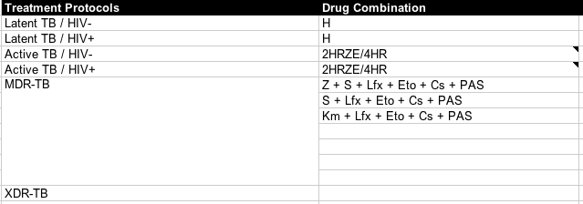
Tab (4) TB regimens and treatment protocols
Column J & K and Row 41-90: Treatment regimens
Column J & K and Row 128-140: Treatment Protocols

Slide 8
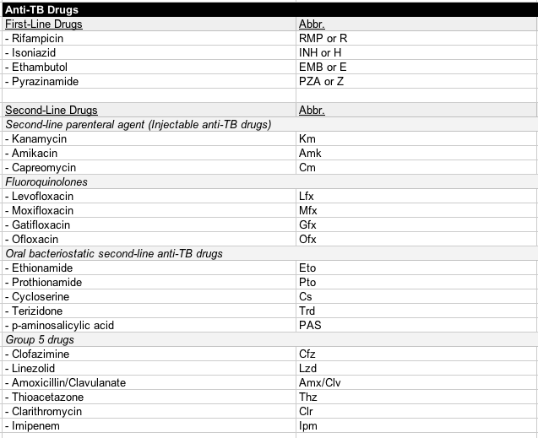
Tab (4) List of Anti-TB drugs
Column J & K and Row 142-171: List of Anti-TB drugs

Slide 9
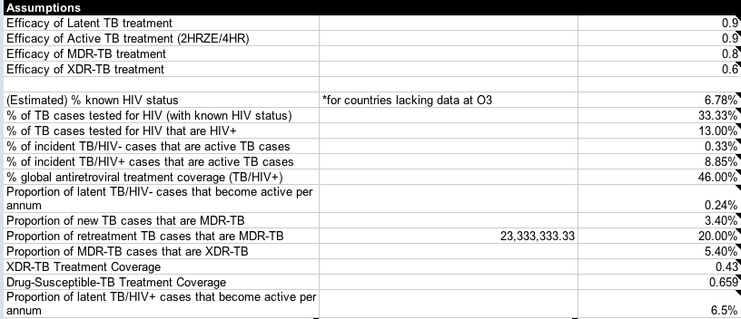
Tab (4) Tuberculosis Assumptions
Column J & K / Row 22-45: Assumptions

Slide 10
Calculating Impact Score: MDR-TB
DALYs lost to MDR-TB by country
Column BG-BM: MDR-TB calculations
The prevalence model: The total number of newly diagnosed cases of a disease (WHO data 2010)
BG: New cases that have MDR-TB
BH: % of new cases that have MDR-TB
BI: Retreatment cases that have MDR-TB
BJ: % of retreatment cases that have MDR TB
BK: Estimated new cases = BG /BH
BL: Estimated retreatment case = BI/BJ
BM: MDR-TB proportion = (BG+BI) / (BK+BL)
DALYs lost to MDR-TB (AI) = Total DALYs lost to TB (D) * MDT-TB proportion (BM) – DALYs lost to XDR-TB (AQ)

Slide 11
Calculating Impact Score: MDR-TB
Treatment Coverage of MDR-TB by country (AH) = # MDR-TB receiving treatment (AF) / # MDR-TB needing treatment (AG)
Treatment Efficacy of MDR-TB (L25): Assumption
AK: Impact of MDR-TB treatment regimen = Need (DALYs lost to MDR-TB (AJ)) * MDR-TB treatment coverage (AH) * MDR-TB treatment efficacy (L25)
A company’s total impact of MDR-TB regimen = The sum of impact of MDR-TB treatment regimen in each country.

Slide 12
Calculating Impact Score: XDR-TB
DALYs lost to XDR-TB by country
Assumption L31: 9% of all MDR-TB cases are XDR-TB (WHO 2013)
DALYs lost to XDR-TB (AQ) = Total DALYs lost to TB (D) * MDT-TB proportion (BM) * 9%
XDR-TB Treatment Coverage (AP) = 43% (assumption L38)
XDR-TB treatment Efficacy (L26) = 0.2 (assumption L26)
Impact of XDR-TB treatment regimen (AR) = Need (DALYs lost to XDR-TB (AQ)) * XDR-TB treatment coverage (AP) * XDR-TB treatment efficacy (L26)
A company’s total impact of XDR-TB regimen = The sum of impact of XDR-TB treatment regimen in each country.

Slide 13
Calculating Impact Score: Normal TB - Needs
Total DALYs lost to normal TB (AS) = Total DALYs lost to TB (D) – the DALYs lost to MDR-TB (AI) – the DALYs lost to XDR-TB (AQ)
AU: DALYs lost to active TB/HIV+ (AU) = total DALYs lost to normal TB (AS) * % latent TB/HIV+ (Z)
AW: DALYs lost to active TB/HIV- (AW)= total DALYs lost to normal TB (AS) * % latent TB/HIV- (AB)

Slide 14
Calculating Impact Score: Normal TB – Access and Efficacy
Treatment coverage for TB/HIV+ (AY) = 65.9% (Assumption about drug-susceptible TB treatment coverage (L39))
Treatment coverage for TB/HIV- (BA) = 65.9% (Assumption about drug-susceptible TB treatment coverage (L39))
Treatment Efficacy of TB/HIV+ (L23): 0.73 (assumption L23)
Treatment Efficacy of TB/HIV- (L24): 0.87 (assumption L24)

Slide 15
Calculating Impact Score: Normal TB
Impact score of active TB/HIV+ treatment regimen (BC) = DALYs lost to active TB/HIV+ (AU) * Treatment coverage for active TB/HIV+ (AY) * Treatment efficacy for active TB (L23)
BF: Impact score of active TB/HIV- treatment regimen (BE) = DALYs lost to active TB/HIV- (AW) * Treatment coverage for active TB/HIV- (BA) * Treatment efficacy for active TB (L24)
A company’s total impact of normal TB regimen = The sum of impact of normal TB treatment regimen in each country.

Slide 16
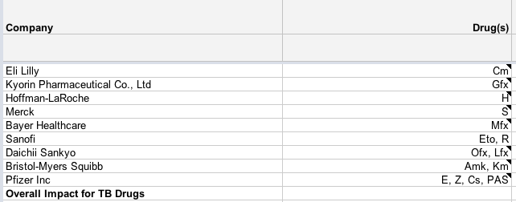
Calculating Impact Score by Companies
Column J and K / Row 5-14: Companies and their drugs
A company’s total impact score in TB = The sum of total impact score in treating normal TB, MDR-TB and XDR-TB

Slide 17
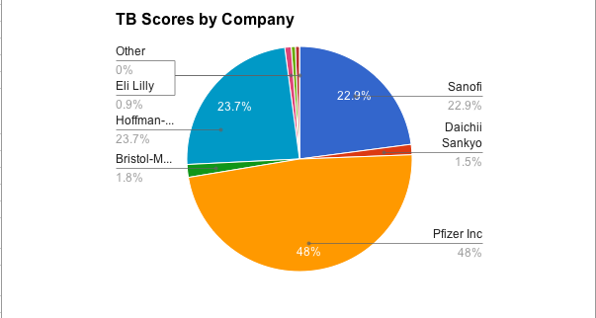
Total TB Impact Scores by Companies

Slide 18
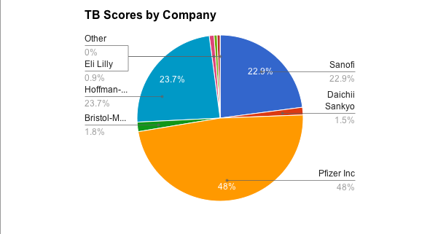
Total TB Impact Scores by Companies

